Slide 1
An Introductory Overview to SLAM Algorithms
Rishab Shah
April 30, 2017

Slide 2
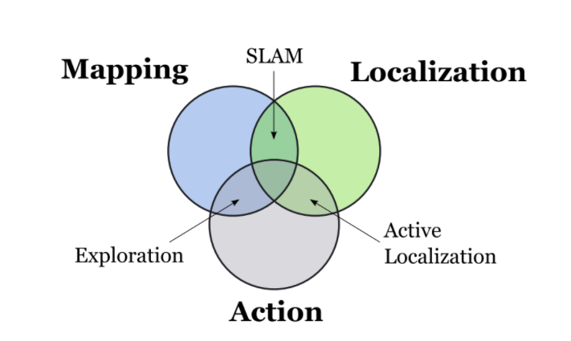
SLAM: Introduction
What is Simultaneous Localization and Mapping (SLAM)?
How do you solve the SLAM problem?

Slide 3
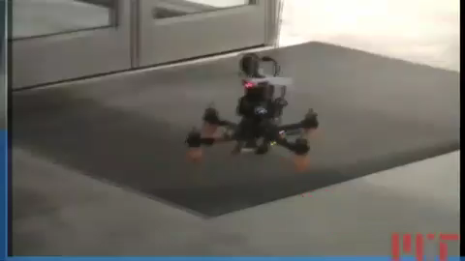
Bachrach, Abraham, Ruijie He, and Nicholas Roy. “Autonomous Flight in Unknown Indoor Environments.” International Journal of Micro Air Vehicles 1 (2009): 217-228. DOI: 10.1260/175682909790291492

Slide 4
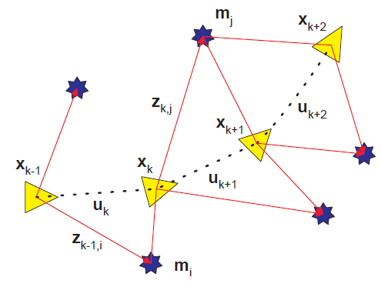
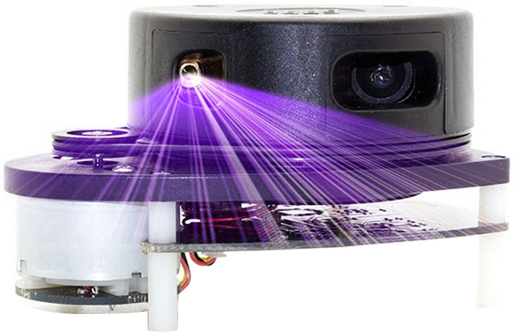
Components of SLAM
Landmark Extraction
Data Association
State Estimation
State Update
Landmark Update
http://www.robotshop.com/media/files/images2/rplidar-360-laser-scanner-7-large.jpg

Slide 5
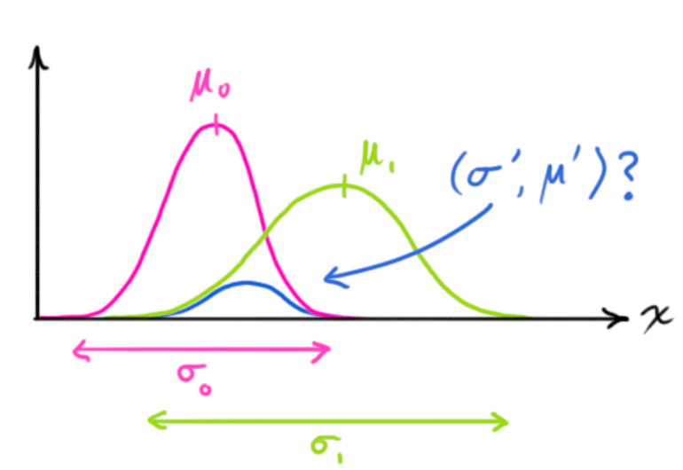
State Estimation
Extended Kalman Filter
Bayesian Filter
Particle Filter
Sequential Monte-Carlo Methods
Rao- Blackwellized Particle Filter
Variants

Slide 6
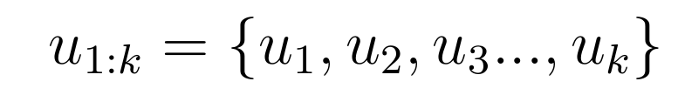
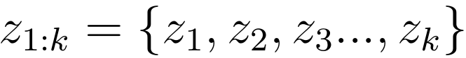
Extended Kalman Filter
Less computationally expensive for moderately dimensioned state space.
Convergence and consistency can be guaranteed in the linear model.
Robot Controls
Observations

Slide 7
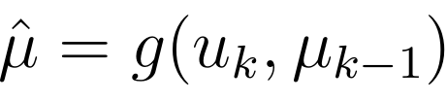
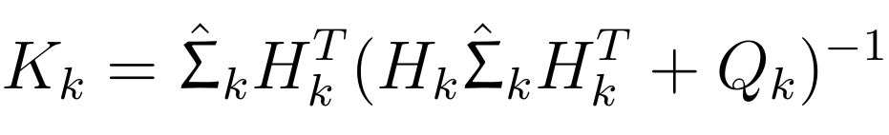
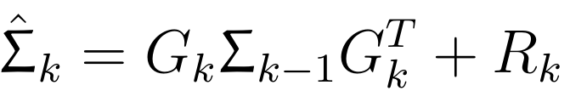
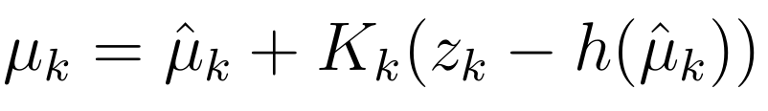
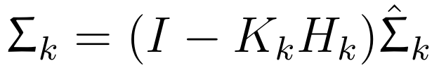
Extended Kalman Filter
Predict Step:
Update Step:
Map convergence is dependent on convergence of map covariance matrix and all landmark pair submatrices, towards zero, which in turn converge to a lower bound determined by initial uncertainties.

Slide 8
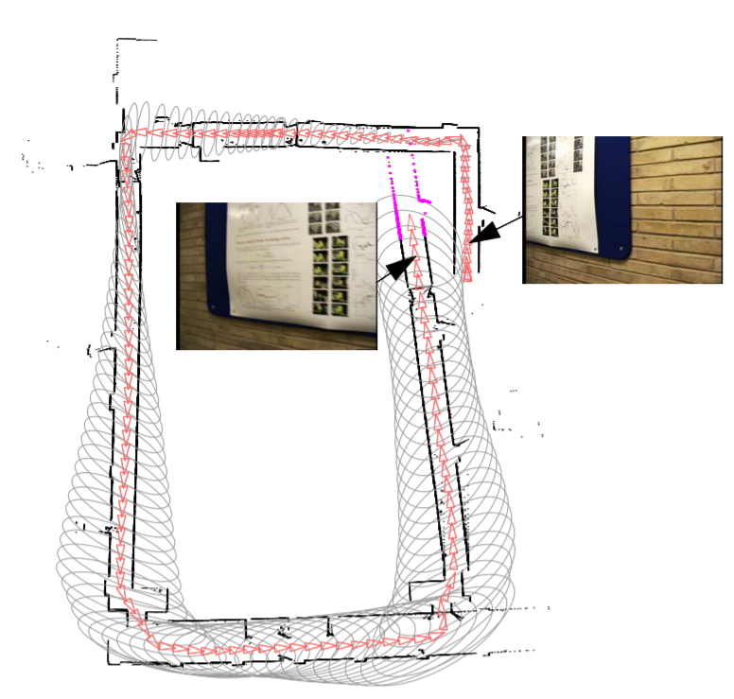
Loop Closure
Recognizing an already
mapped area.
Data Association with
high ambiguity.
P. Newman and Kin Ho, "SLAM-Loop Closing with Visually Salient Features," Proceedings of the 2005 IEEE International Conference on Robotics and Automation, 2005, pp. 635-642.

Slide 9
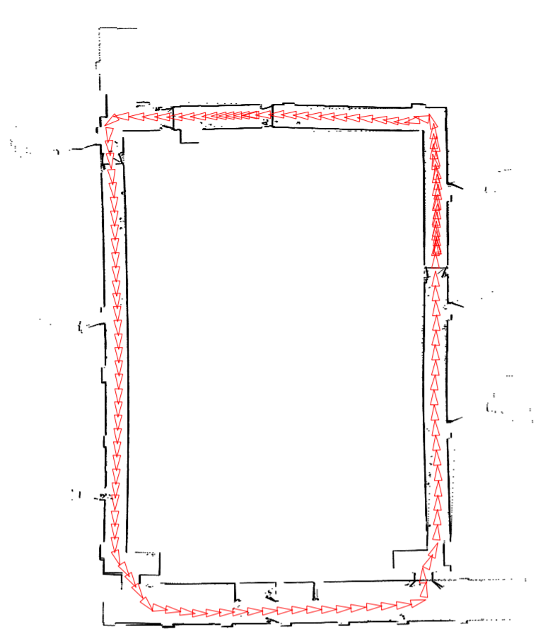
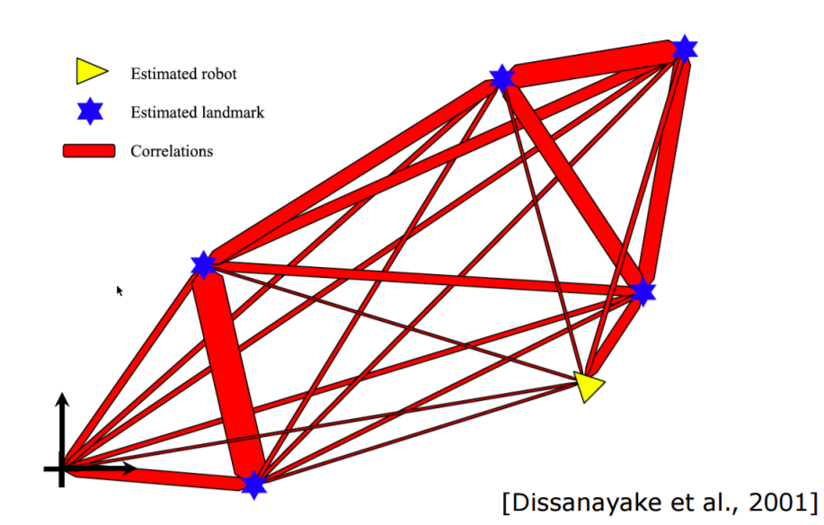
Loop Closure
Uncertainties collapse
after a loop closure.
P. Newman and Kin Ho, "SLAM-Loop Closing with Visually Salient Features," Proceedings of the 2005 IEEE International Conference on Robotics and Automation, 2005, pp. 635-642.

Slide 10
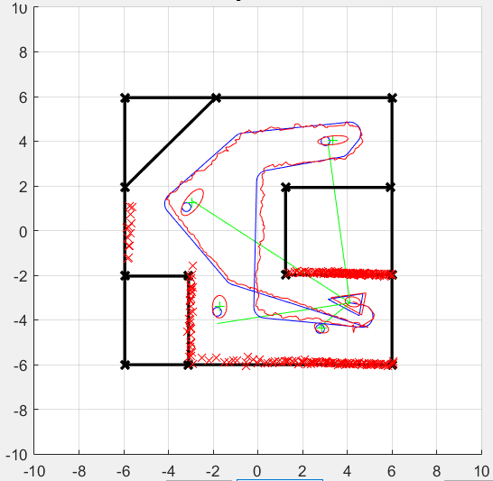
Simulation

Slide 11
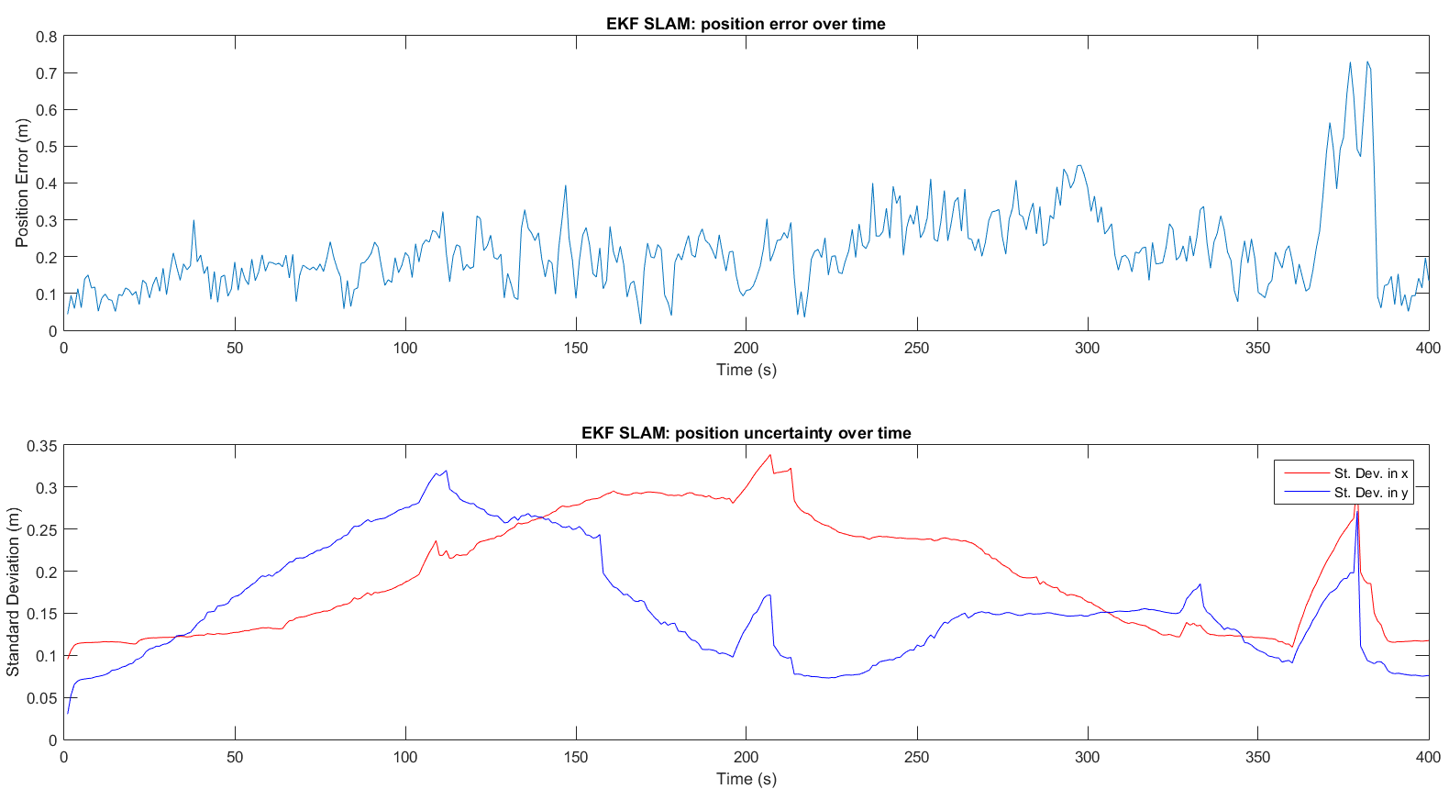
Simulation

Slide 12
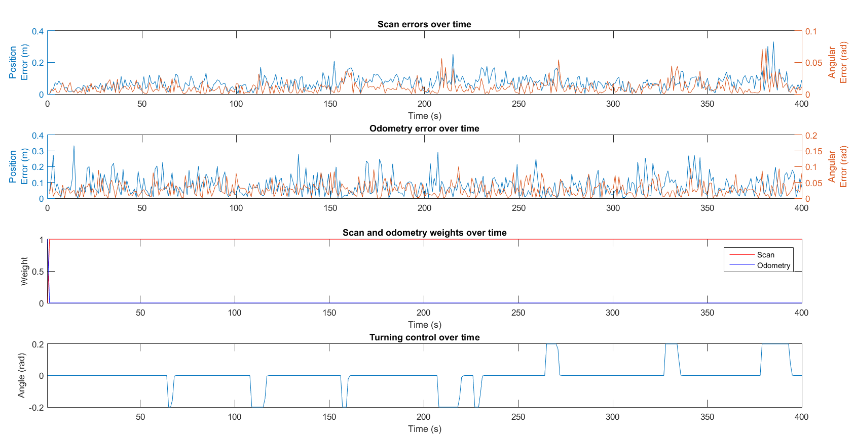
Simulation

Slide 13
Rao- Blackwellized Particle Filter
Particle Filters are non-parametric, recursive Bayes filters.
Not limited to Gaussian distributions and noise models.
Weighting at each step.
Resampling required.
Works well in low-dimensional spaces.
Monte-Carlo Localization, which is the standard for mobile robot localization today.

Slide 14
Rao- Blackwellized Particle Filter
Joint SLAM state factored as robot component and conditional map component:
Directly represents non-linear process model.
Still linearizes the observation model but is a reasonable approximation for range-bearing measurements when robot pose is known.

Slide 15
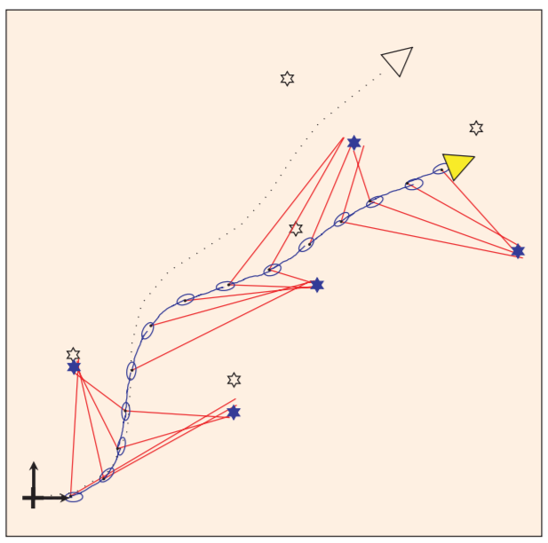
Rao- Blackwellized Particle Filter
Hugh Durrant-Whyte and Tim Bailey, Simultaneous Localisation and Mapping (SLAM): Part I The Essential Algorithms, IEEE Robotics and Automation Magazine, 2006, Vol.2

Slide 16
Feature Extraction & Data Association
RANSAC (Random Sampling and Consensus) and variants (MSAC, MLSAC ,etc.) for feature extraction.
Robust model fitting.
Data association use advanced image processing techniques that extract features from an image frame.
HoG, LoG
SIFT, SURF, BRIEF
ORB, FREAK

Slide 17
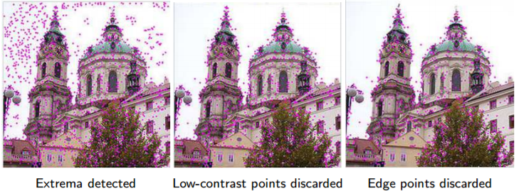
SIFT: Example
It may be very efficiently implemented and it is widely used for image matching in motion and object classification.

Slide 18
History and State-of-the-art SLAM
Deterministic SLAM
2D SLAM
Online vs. Offline SLAM
Monocular vs. Stereo SLAM
Dense vs. Sparse Feature based SLAM
Discrete vs. Continuous-time SLAM
Continuous-time uncertainty-constrained exploration, while maintaining localization uncertainty within given bounds.

Slide 19
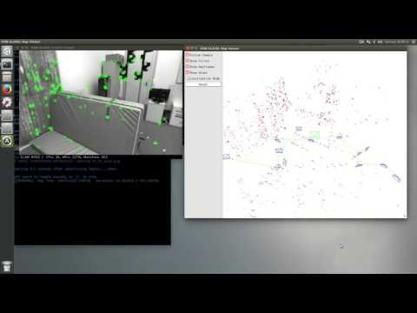
State-of-the-art SLAM algorithms
An Introductory Overview to SLAM algorithms
Raúl Mur-Artal and Juan D. Tardós. ORB-SLAM2: an Open-Source SLAM System for Monocular, Stereo and RGB-D Cameras. ArXiv preprint arXiv:1610.06475. 2016

Slide 20
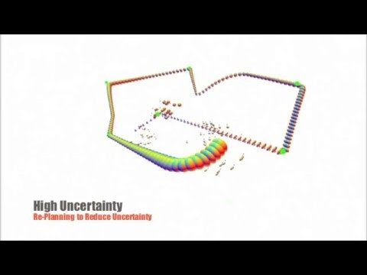
State-of-the-art SLAM algorithms
An Introductory Overview to SLAM algorithms
Vadim Indelman, Luca Carlone, Frank Dellaert , Planning in the continuous domain: A generalized belief space approach for autonomous navigation in unknown environments The International Journal of Robotics Research Vol 34, Issue 7, pp. 849 - 882

Slide 21
Thank YOU

